Slide 1

FYP Progress recorder
Team Members:
Aimun Akbar
Irza Hasan
Rida Shaikh
Zareen Khan
Supervisor:
Ms. Soomaiya Hamid
Co Supervisor:
Ms. Arifa Shamim

Slide 2
Background
The project aims is to address specific hectic points within the CSSE department, applying advance technology to create a robust and adaptable solution.

Slide 3
Problem Statement
To maintain the manual records of Final Year Projects (FYP) is a hectic job for a FYP Coordinator.
There are many tasks and documentations have to be managed and schedule presentations and FYP meetings.
Supervisors and student collaboration has to be recorded to maintain project progress.
Therefore, there is a need to maintain these tasks by an automated system.
In addition to this, it is also difficult to notify students related to submission deadlines and give warnings to students after the deadline.

Slide 4
Existing Solutions
The following are the few existing solutions to manage the progress of projects.
Trello
Freedcamp
Google Projects
Jira
Notion
LMS

Slide 5
Limitations of Existing Solutions
Main limitation of existing solution is we need a system for the specific purpose. We can’t do our desired activities in existing solutions.
One of the existing solution which had been done 2 years back.
There is no feature to maintain and calculate results. It only shows student’s data.
No Plagiarism checker feature.
No feature to give warnings to students.

Slide 6
Proposed Solution
This project will calculate progress of FYPs, scheduling FYP meetings and presentations along with its records.
It will generate a FYP progress report and display results to students and faculty.
Plagiarism checker to check student’s submitted project reports and presentations.

Slide 7
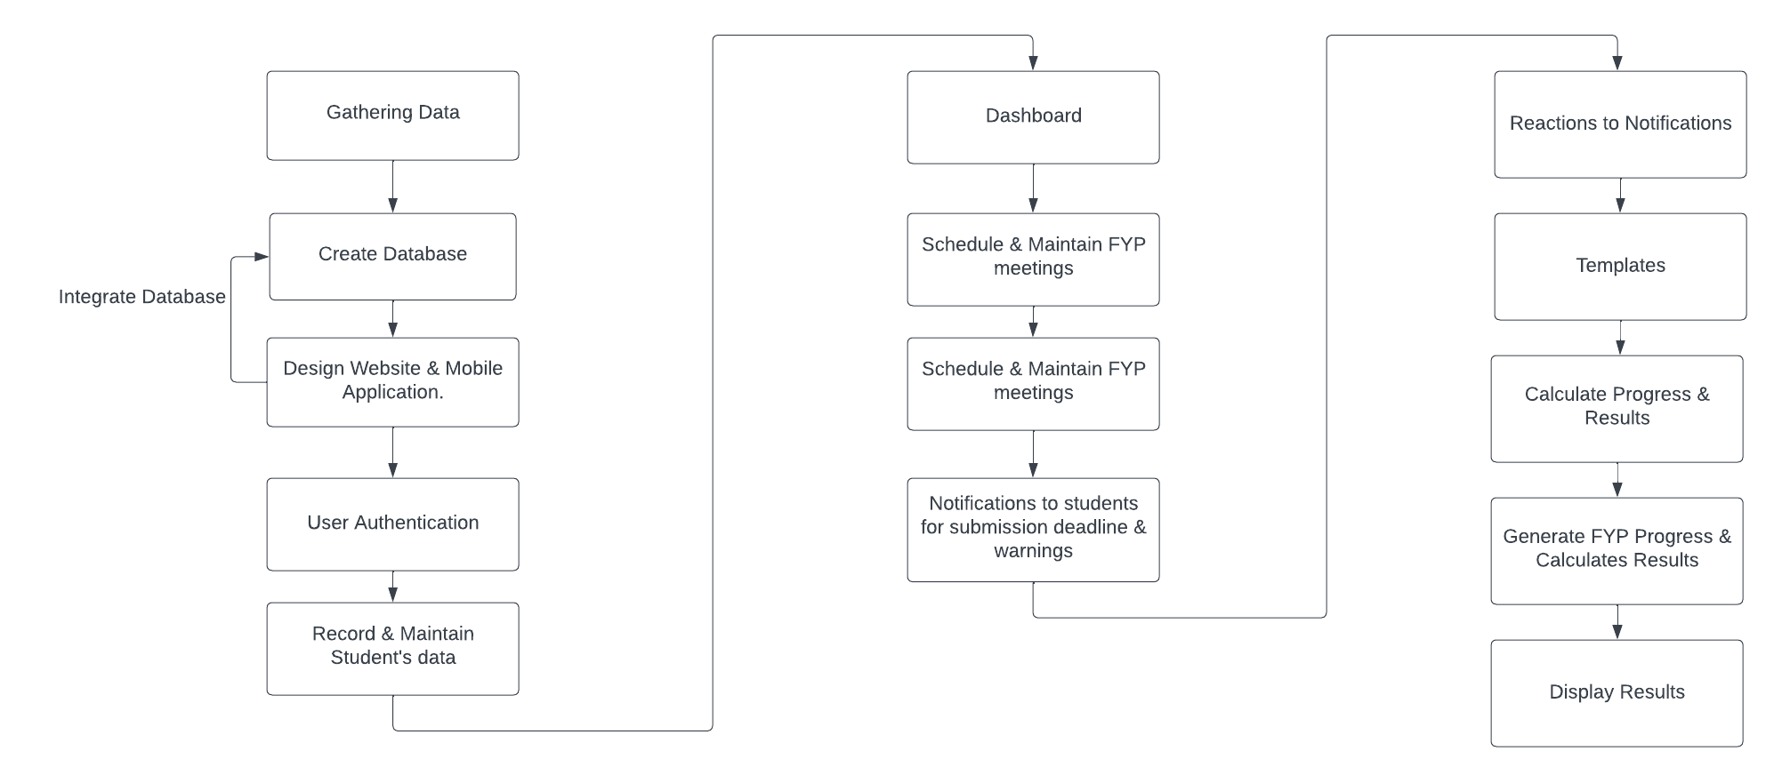
Methodology

Slide 8
Scope
This project can serve as a valuable system for efficiently and quickly managing and documenting the final year project process within the CSSE department in Jinnah University for Women.

Slide 9
Data Gathering
We will gather data (students and their project records) from Jinnah University for Women department of Computer Science and Software Engineering, because this system is specifically for our department to manage FYP.
The system gathers data from various sources, including department databases and registration systems.

Slide 10
Web & mobile application Features
Roles
Admin
FYP coordinator
Students
Supervisor
External Evaluators

Slide 11
Web & mobile application Features
Admin
Register supervisors and students
Maintain student’s data and records
FYP Coordinator
Schedule meetings and presentation
Review progress
Students
Submit projects and reports
View progress, results
Can react on uploaded post

Slide 12
Web & mobile application Features
Supervisor
Create forums
Generate notifications (deadline, notifications)
Schedule meetings and presentation
Calculate progress
External Evaluators
Evaluate and review projects

Slide 13
Web & mobile application Features
User Authentication
Record and maintain Student’s data
Database integration
Dashboard
Schedule and maintain FYP meetings by supervisors
Schedule and maintain presentations by FYP coordinators
Notifications to students for submission deadline
Notification to students for warning
React to uploaded notification on dashboard
Templates
Calculate progress
Calculate FYP progress and results
Generate FYP progress and result report
Display results
Integration with APIs

Slide 14
Web & mobile application Features
User Authentication
Implement a secure login system to ensure that only authorized personnel (students, supervisors, coordinators and administrators) have access to specific features and information.
Record and Maintain Student’s data
Keeping track of students data of final year projects. It includes creating a system to manage and store information or data about students and details of their specific projects.

Slide 15
Web & mobile application Features
Database Integration
This feature involves database system to store information, including student details, project proposals, meeting schedules, project progress, evaluations, and more.
Dashboard
It includes various components to provide students and supervisors with instant insights and efficient navigation.
Users can monitor upcoming task such as meetings and presentations, and track the progress of individual projects through visually intuitive indicators.
The dashboard also facilitates quick access to recent activities, notifications, and student profiles, streamlining communication and collaboration.

Slide 16
Web & mobile application Features
Schedule and maintain FYP meetings by supervisors
Supervisors and students equally must prepare for these meetings.
A clear plan that is given out in advance sets the stage for discussions and includes updates on accomplishment , challenges encountered and future plans.
Schedule and maintain presentations by FYP coordinators
Keeping track of presentations by FYP coordinators involves creating a regular timetable for students project demonstrations and offering a forum for updates, opinion and analysis.

Slide 17
Web & mobile application Features
Notifications to students for submission deadline
This feature will give full details on submission requirement including particular instructions or updates related to the tasks. This system will send timely reminder for submission deadline.
With one click, students will be able to submit tasks effortlessly.
Notifications to students for warning
This feature will be design to alert students automatically when there is a risk to their performance, giving them timely notice for incomplete tasks.

Slide 18
Web & mobile application Features
Reactions
Student can react on uploaded notifications in dashboard.
Templates
This feature offers students a pre-designed templates for presentations and project reports.
Calculate progress
Evaluating different factors that shows how far along a project ha come in terms to it goals and timetables. For instance:
Define Milestones
Track Completion
Scheduled tasks vs completed tasks

Slide 19
Web & mobile application Features
Calculate progress and results
This feature will generate current and accurate progress report.
These reports indicate tasks that have been completed, highlight continuing projects and show delays or bottlenecks.
Generate FYP progress and result report
Progress and outcome reports of FYP’s will be automatically created
It will provide a detail summary of each student’s milestones.

Slide 20
Web & mobile application Features
Display results
Progress results can be shown and shared.
Students will be able to view their performance, progress and feedbacks.
Integration with APIs
Calendar API to manage project milestones and schedule meeting and presentation.
Communication API to enhance notification and alert feature of system (e.g., Twilio, SendGrid).

Slide 21
AI Features
AI-Based Plagiarism Checker
Textual Analysis
Natural Language Processing (NLP) techniques to analyze the text content of project documents.
Paraphrasing Detection
Detect paraphrased content by comparing sentence structures, synonyms, and contextual meaning.
Integration with APIs
Tunitin, Unicheck, PlagScan API can be used for our AI feature.

Slide 22
Target Audience
The target audience for the "Final Year Project Progress Recorder" associated with the CSSE department in the university are following:
Admin
FYP coordinators
Students
Supervisor
External Evaluators

Slide 23
Industry Collaboration
Jinnah University for Women (Department of Computer Science and Software Engineering).

Slide 24
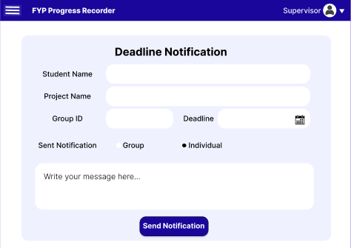
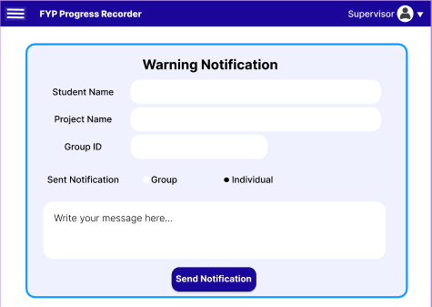
Web Application Expected Prototype of Project
Notifications to students for submission deadlines and Warning

Slide 25
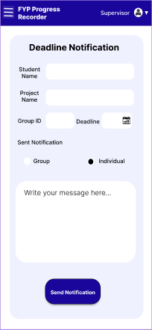
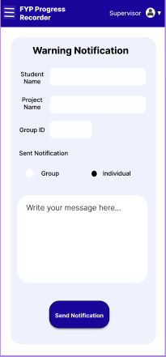
Mobile Application Expected Prototype of Project
Notifications to students for submission deadlines and Warning.

Slide 26
Sustainable Development Goal
(SKG 4 goal: Quality Education)
Enhance learning opportunity
By offering a streamlined process for project management, the system contributes to an enriched learning environment
Efficient Resource Allocation
The system ensuring that supervisors can effectively mentor students, and students can access the necessary support and guidance.

Slide 27
Tools and Technology
Technologies
For WebApp
Front-End: Html, CSS, JavaScript
Backend: Python, PHP
For MobileApp
Flutter
For Database
MySQL

Slide 28
Tools and Technology
Tools
Figma
VS Code
Python IDE
Xampp Server
Android
Github

Slide 29
Thank You

